Slide 1
CIMT CAPSTONE PROJECT · FINAL PRESENTATION
AI-Powered Smart Retail
Analytics Platform
Results, Trained Models & the Deployed NovaMart Dashboard
Dataset: Olist Brazilian E-Commerce (Kaggle) | Company: NovaMart (fictional)
9 Modules Built · 113,049 Orders Analysed · 1 Deployed Streamlit Dashboard
Notes:
Good morning / afternoon everyone. Today I'm presenting my capstone project: the AI-Powered Smart Retail Analytics Platform, built for a fictional company called NovaMart. NovaMart is modelled on a real dataset — the Olist Brazilian E-Commerce dataset — so everything I'll show today is grounded in real transactional data, not a toy example. Over the course of this project I built a nine-module analytics pipeline end to end: data acquisition, feature engineering, exploratory data analysis, customer segmentation, sales forecasting, delivery-delay and satisfaction prediction, a product recommendation engine, model explainability, and finally a live Streamlit dashboard that ties every module together into one interactive application. Today I'll walk through the business problem, what I built for each module, what the models actually found, and what it means for NovaMart's business — including the results that worked well and the ones that didn't, because both are useful.

Slide 2
BUSINESS CONTEXT
NovaMart & The Business Problem
A fictional multinational e-commerce company — real business challenges, solved with real data.
Who is NovaMart?
Business Challenges Addressed
Multinational online marketplace, comparable in scale to Amazon or Shopee
Thousands of products across dozens of categories
Large, geographically dispersed customer and seller base
Rich transactional data generated every day — orders, payments, reviews, delivery events
No way to distinguish valuable customers from one-time buyers
No reliable forecast of future sales for planning and budgeting
Delivery delays go undetected until a customer complains
No personalised product recommendations
AI predictions offered no explanation stakeholders could trust
2
Notes:
Before getting into the modules, let me set up the business context. NovaMart is a fictional multinational e-commerce company, comparable in scale to a platform like Amazon or Shopee, and it faces five analytical blind spots that are very common in growing e-commerce businesses: it can't tell its most valuable customers apart from one-time buyers, it has no reliable way to forecast future sales, delivery delays only surface after a customer complains, there's no personalised product recommendation capability, and where predictive models did exist, they offered no explanation a business stakeholder could trust or act on. Each of these five gaps maps directly onto one of the platform's modules, which I'll walk through one at a time, each backed by an actual trained model and a real, measured result.

Slide 3
DATA FOUNDATION
The Dataset: From 9 Raw Tables to 1 Master Dataset
9
113,049
46
Sep '16 – Aug '18
Olist Relational Tables Merged
Final Order-Item Records
Engineered Variables
Observation Window
Data Engineering Highlights
Why Olist?
Merged customers, orders, order items, products, sellers, payments, reviews, geolocation & category-translation tables via relational keys
Removed 1 anomalous order with no payment record (3 rows) and 265 exact duplicate rows introduced during merge
Missing delivery timestamps (2.2%) and review scores (0.8%) retained as valid business states, not imputed
Real-world relational structure simulating an enterprise retail database
Supports every task type used in this project: clustering, time-series, classification, and association-rule mining
One coherent dataset powers all nine modules — no dataset juggling
3
Notes:
The platform runs entirely on the Olist Brazilian E-Commerce dataset. Building the analytical dataset required genuine data engineering: resolving foreign keys across nine tables, and reconciling one-to-many relationships. After merging, I found and removed one anomalous order with no payment record and 265 duplicate rows, leaving a clean 113,049-row, 46-column master dataset that every subsequent module was built on.

Slide 4
WHAT WAS BUILT
Platform Architecture — Nine Modules Delivered
00
Data Acquisition
01
Feature Engineering
02
Exploratory Data Analysis
Merge 9 tables into 1 dataset
RFM, delivery & payment features
Sales, delivery, satisfaction patterns
03
Customer Segmentation
04
Sales Forecasting
05
Delivery Delay Prediction
K-Means → 5 customer segments
ARIMA daily revenue forecasting
Random Forest classifier
06
Customer Satisfaction Prediction
07
Recommendation Engine
08
Model Explainability
Random Forest classifier
Popularity, cluster & rating-based
Feature-importance analysis
4
Notes:
Here's the architecture end to end. All nine modules were completed on the same master dataset, so nothing downstream had to re-derive or re-clean data — every module builds on the same 113,049-row foundation. A couple of deliberate design decisions worth calling out: I did not build a standalone fraud or anomaly-detection model, because Olist provides no labelled fraud data to validate one against — instead, risk-flagging is handled through the explainability and dashboard layer, using the same feature-importance logic as the delivery and satisfaction models. And the ninth module, the BI dashboard, is the final deliverable I'll demo later — a Streamlit application built on top of the eight analytical modules that lets a NovaMart stakeholder interact with all of this without opening a single notebook.

Slide 5
METHODOLOGY
The Seven-Step Machine Learning Lifecycle
Every one of the seven steps was completed for all nine modules — this lifecycle is the backbone of the results on the following slides.
1
2
3
4
5
6
7
Data Acquisition
Data Preprocessing
Exploratory Data Analysis
Feature Engineering
ML Model Development
Model Explainability
Dashboard Deployment
Merge 9 Olist tables via relational keys
Handle missing values, remove duplicates
Uncover sales, delivery & behaviour patterns
Delivery, RFM, and payment-based features
Train & compare models per module
Random Forest feature-importance analysis
Streamlit app integrating all modules
5
Notes:
Every module in this project followed the same seven-step lifecycle, shown here: acquire the data, clean and preprocess it, explore it, engineer features from it, build and compare machine learning models, explain what those models are doing, and finally deploy the result into the dashboard. I'm showing this upfront because it's the structure behind every slide that follows — when I walk through, say, the segmentation or forecasting module, I'm really walking through steps 3 through 6 of this lifecycle applied to that specific business question. The results on the next several slides are real, measured outputs of this process, not projections.

Slide 6
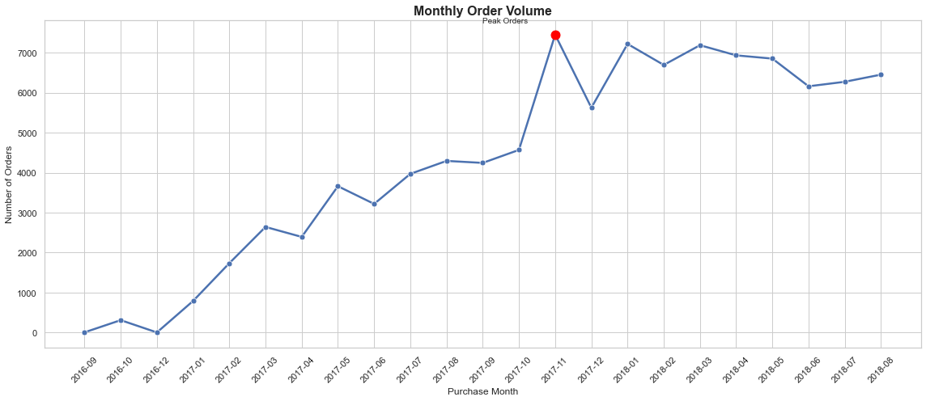
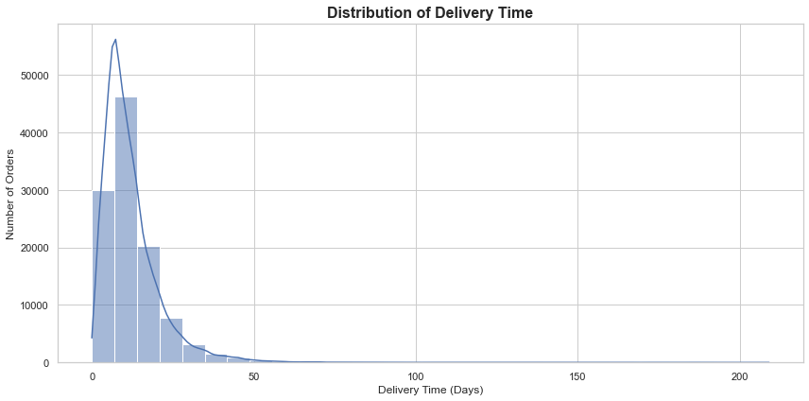
MODULE 02 · RESULTS
EDA — Sales Growth & Delivery Performance
Key Findings
Order volume grew from a handful of pilot orders in late 2016 to a stable plateau of 6,000–7,200 orders/month by mid-2017
A clear Black Friday peak of 7,400+ orders in November 2017
Delivery time is right-skewed: median ≈ 10 days, but a long tail exceeds 100 days in rare cases
This skew directly shaped feature choices in the delivery-delay and satisfaction models (Modules 05–06)
Figure: Monthly order volume, Sep 2016 – Aug 2018
10 days
6.5%
Median Delivery Time
Orders Delivered Late
Figure: Distribution of delivery time (days)
6
Notes:
Order volume shows healthy, sustained growth with a clear Black Friday spike — useful context for the forecasting module later. Delivery time is heavily right-skewed: most orders arrive in 6-20 days, but a long tail of extreme delays disproportionately affects customer experience, which becomes very relevant when we look at satisfaction prediction.

Slide 7
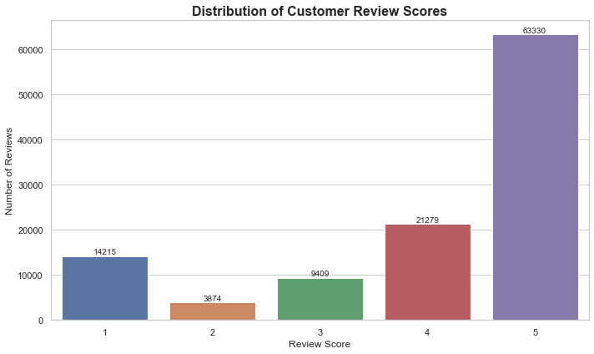
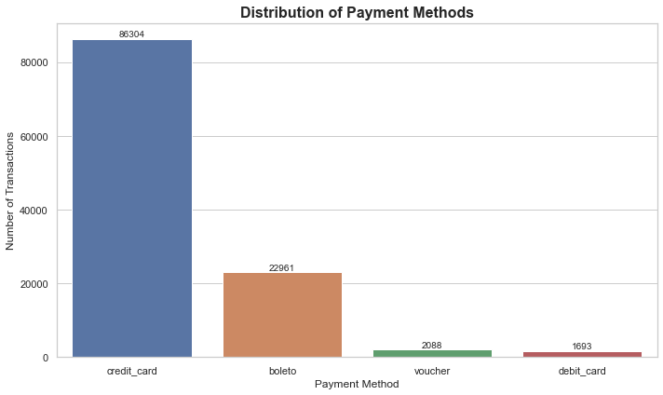
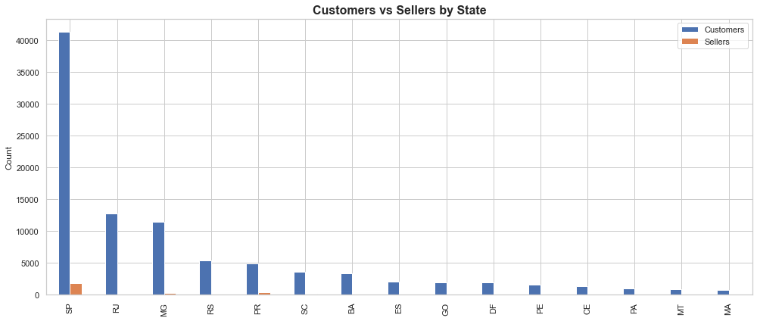
MODULE 02 · RESULTS
EDA — Customer Satisfaction, Geography & Payments
Review score distribution
Customers vs sellers by state
Payment method distribution
Key Findings
73.4% of reviews are rated 4 or 5 stars — satisfaction is high on average, but the remaining ~16% at 1–2 stars is where the real business risk sits
São Paulo (SP) alone accounts for 40,000+ customers, roughly 3× Rio de Janeiro (RJ), and hosts the large majority of sellers too — intra-state delivery dominates NovaMart's logistics network
Credit card is used in 76% of transactions, followed by boleto (bank slip) at 20% — this distinction later helped separate customer segments in Module 03
7
Notes:
Three more EDA findings that fed directly into later modules: satisfaction is skewed positive but with a meaningful unhappy minority; the customer and seller base is heavily concentrated in south-eastern Brazil, which matters for delivery-distance features; and credit card dominates payment behaviour, which turned out to be a genuine differentiator between customer segments.

Slide 8
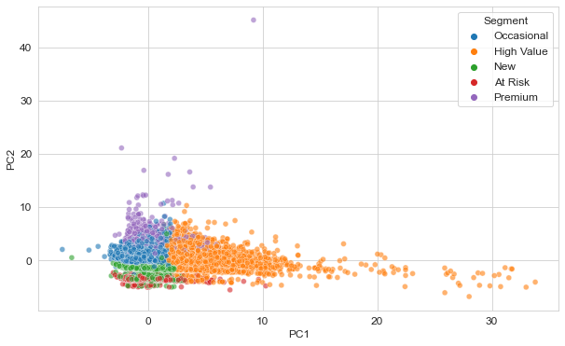
MODULE 03 · RESULTS
Customer Segmentation — Five Actionable Segments
Segment | Size | Avg. Spend | Avg. Review
Occasional | 63,632 | R$198.62 | 4.28
At Risk | 8,677 | R$262.16 | 2.53
Premium | 2,873 | R$614.48 | 4.16
Value / Boleto | 18,775 | R$183.54 | 4.24
New | 1,463 | R$169.97 | 4.18
Key Findings
Only 3.05% of ~95,000 customers made more than one purchase — retention, not acquisition, is NovaMart's biggest lever
Premium (2,873 customers) is the only segment with repeat purchasing and by far the highest spend
At Risk pairs above-average spend with the worst delivery experience and lowest reviews of any segment — a clear retention target
PCA projection of K-Means segments (K=5)
8
Notes:
K=5 was chosen balancing the elbow method, silhouette score, and business interpretability. The most important finding here isn't the clusters themselves — it's that 97% of customers never come back. That single fact reframes almost every recommendation later in this deck around retention rather than acquisition.

Slide 9
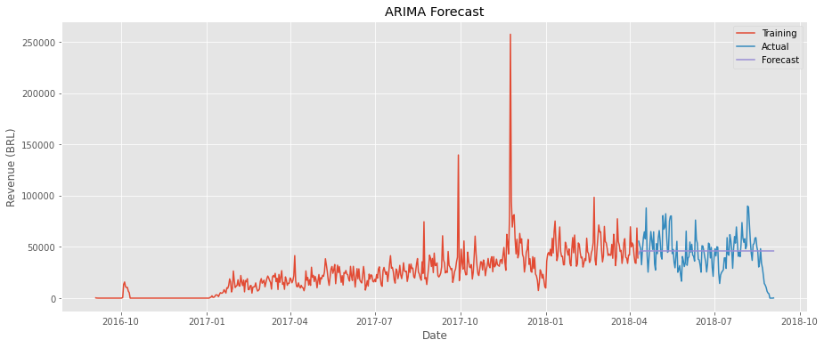
MODULE 04 · RESULTS
Sales Forecasting — ARIMA on Daily Revenue
Order | RMSE | MAPE | R²
(3,1,2) ★ best | 18,940.9 | 246.4% | -0.02
(2,1,1) | 18,951.0 | 246.9% | -0.02
(1,1,2) | 18,954.6 | 247.0% | -0.02
⚠ Honest Limitation
Best model's R² is negative — no better than predicting the mean
MAPE of 246% reflects irregular promotional spikes ARIMA cannot capture
Recommended fix: exogenous regressors (promo calendar, holidays) or monthly/category-level aggregation
ARIMA(3,1,2) forecast vs. actual test-period revenue
9
Notes:
This is a deliberately honest result. Six ARIMA specifications were compared; the best by RMSE still produced a negative R². Daily NovaMart revenue is dominated by irregular promotional spikes rather than smooth seasonality, which classical linear time-series models aren't built to capture. I'm presenting this as a genuine finding and a roadmap for improvement, not hiding it — that's the difference between a classroom exercise and an honest applied project.

Slide 10
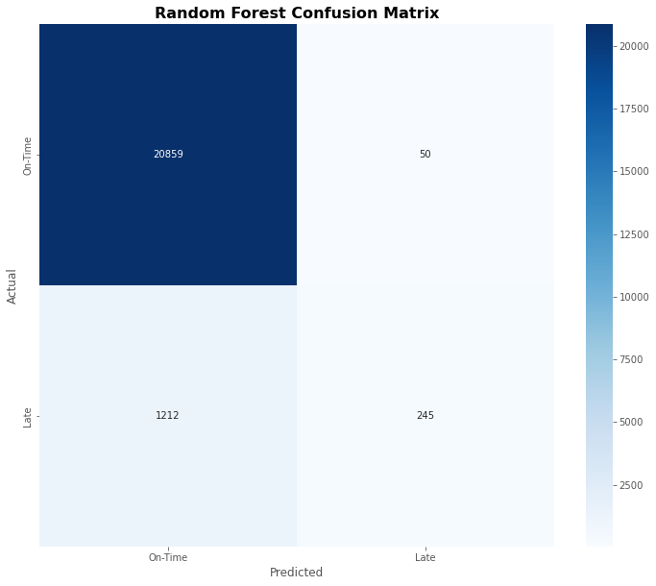
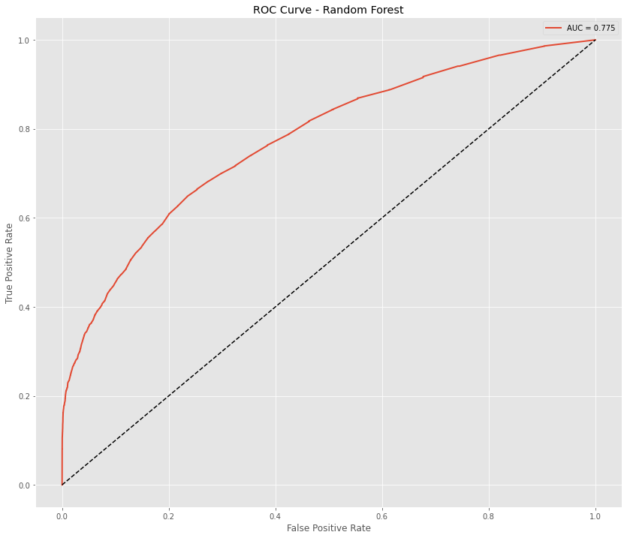
MODULE 05 · RESULTS
Delivery Delay Prediction — Random Forest
Model | Accuracy | Precision | Recall
Random Forest ★ | 0.944 | 0.831 | 0.168
Decision Tree | 0.937 | 0.607 | 0.074
Logistic Reg. | 0.935 | 0.625 | 0.021
Key Findings
High precision (0.83): when flagged late, it's right ~4 in 5 times
Low recall (0.17): most late deliveries still go undetected — a hard minority-class problem at only 6.5% prevalence
SMOTE oversampling did not improve results — the signal simply isn't in the order-level features
Recommended as a decision-support flag, not a full detector
Confusion matrix
ROC curve (AUC = 0.775)
10
Notes:
Random Forest was the strongest of three classifiers, with high precision but low recall on the late-delivery minority class. I tested SMOTE to address the class imbalance — it didn't help, which tells us the limiting factor is the available features, not the algorithm. This model should be used as a prioritisation tool for operations teams, not a stand-alone detector.

Slide 11
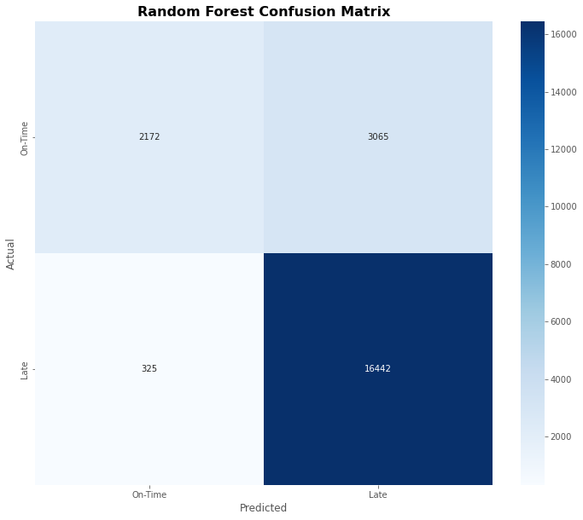
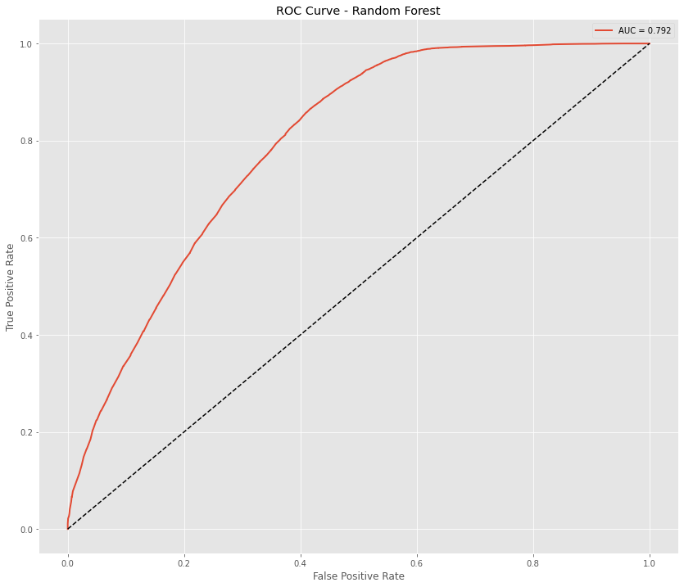
MODULE 06 · RESULTS
Customer Satisfaction Prediction — Random Forest
Model | Accuracy | Recall | F1
Random Forest ★ | 0.846 | 0.981 | 0.907
Decision Tree | 0.800 | 0.972 | 0.881
Logistic Reg. | 0.790 | 0.977 | 0.877
Key Findings
98.1% recall — the model catches almost every satisfied customer, isolating the at-risk minority reliably
Delivery-related features dominate: delay and total delivery time are the strongest predictors
Ready for deployment as a proactive early-warning flag before a negative review is even submitted
Confusion matrix
ROC curve (AUC = 0.792)
11
Notes:
This model performed noticeably better than delivery prediction — 84.6% accuracy with 98.1% recall. In practice this means the customer-service team could flag the smaller group of likely-dissatisfied orders with high confidence and intervene before the customer ever leaves a review.

Slide 12
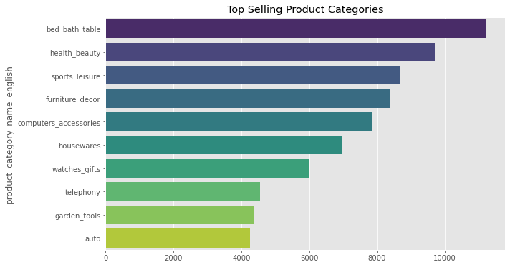
MODULE 07 · RESULTS
Product Recommendation Engine
What Actually Worked
Apriori market-basket analysis (0.5% min. support) found NO significant cross-category association rules
NovaMart orders are highly concentrated within single categories, not predictable multi-category baskets
Deployed engine instead blends: popularity, customer-cluster preference, and best-rated products (min. review threshold applied)
A finding, not a failure:
with only a 3% repeat-purchase rate, there isn't yet enough basket density for classic association rules to fire — the hybrid approach is the right engineering response to what the data actually shows.
Top-selling product categories by order volume
12
Notes:
One of the more instructive findings of the whole project. I ran Apriori association-rule mining at the category level and found no rules meeting minimum lift and confidence thresholds — NovaMart baskets are single-category dominant. Rather than force a weak cross-selling model, the deployed engine blends popularity, segment, and rating signals, which is a more honest engineering response given the data.

Slide 13
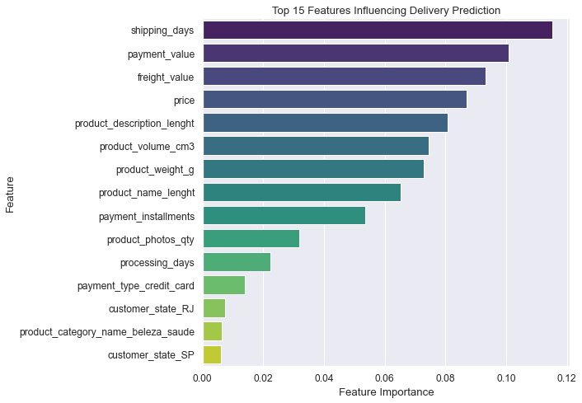
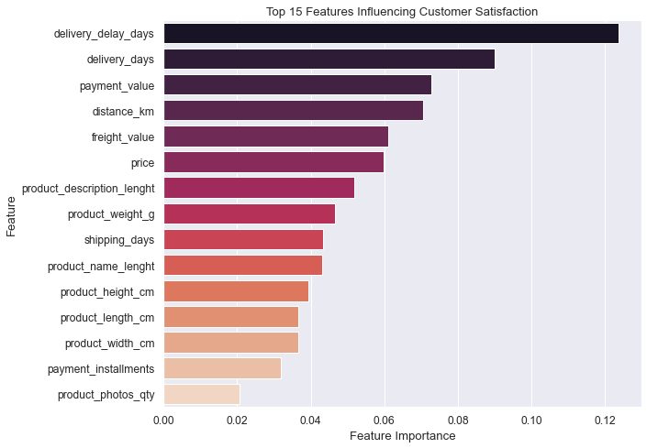
MODULE 08 · RESULTS
Model Explainability — What Drives Each Prediction
Top features — delivery delay
Top features — customer satisfaction
Bottom line: shipping duration and transaction value drive delivery risk; delivery delay itself is the #1 driver of dissatisfaction — logistics is NovaMart's highest-leverage improvement area.
13
Notes:
Both models were interpreted using Random Forest feature importance. Shipping duration, payment value, and freight cost dominate delivery-delay risk. For satisfaction, delivery delay and total delivery time are, unsurprisingly, the two strongest predictors — confirming, at the feature level, exactly what the EDA correlation analysis suggested at the start.

Slide 14
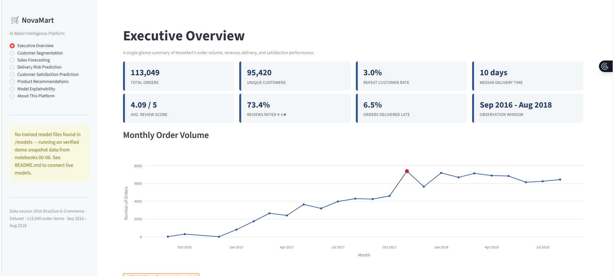
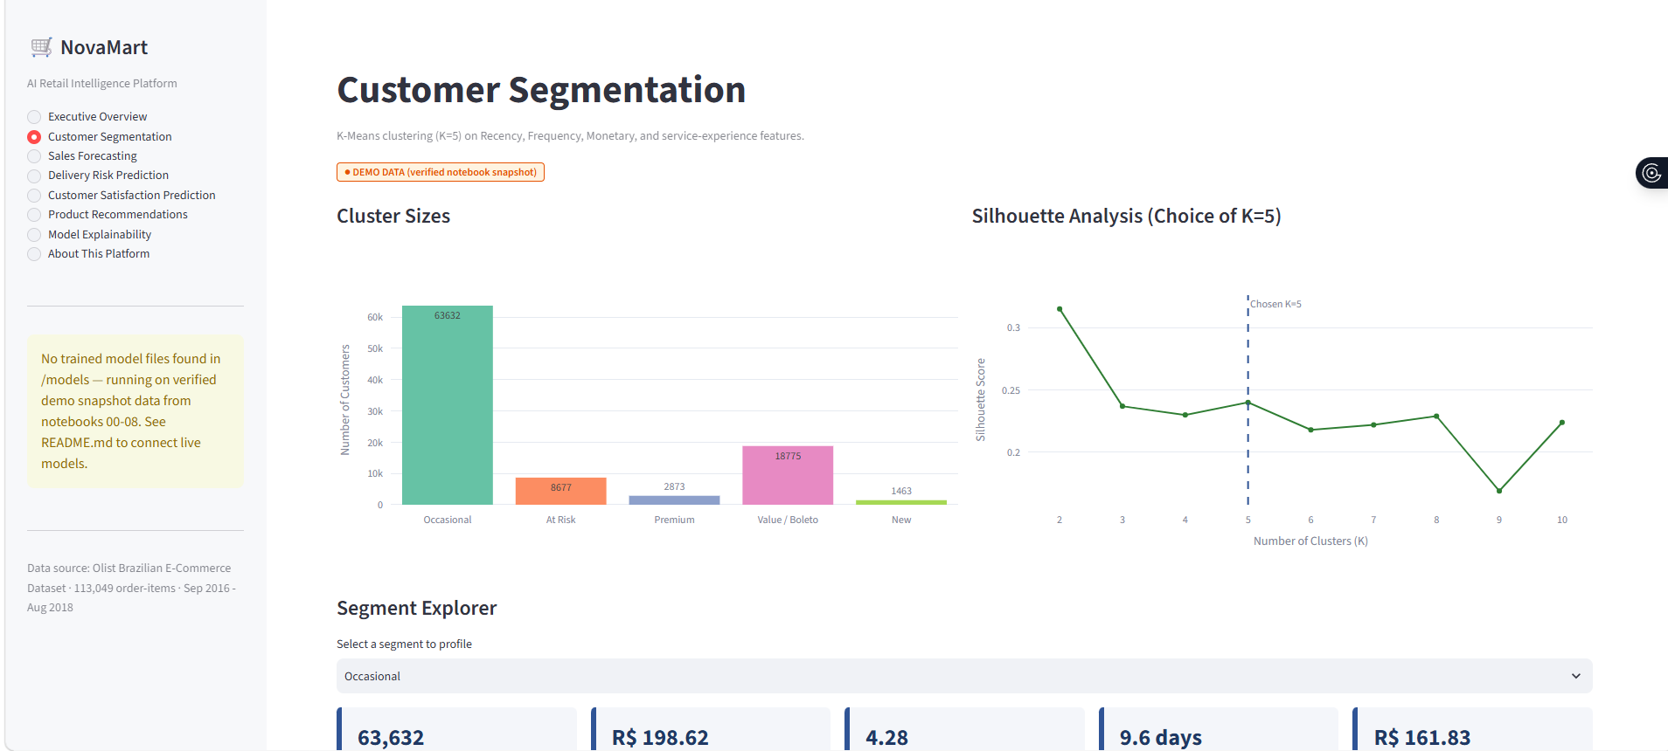
DEPLOYMENT
The NovaMart Dashboard — Live & Deployed
● LIVE DEPLOYMENT
Executive Overview — KPIs & order volume trend
Customer Segmentation — cluster sizes & silhouette analysis
14
Notes:
This is the deployed application, running on my own machine via Streamlit — not a mockup. On the left, the Executive Overview page surfaces the same KPIs and order-volume trend from the EDA module. On the right, Customer Segmentation lets a NovaMart stakeholder explore the five segments interactively — cluster sizes, silhouette analysis, and a segment profiler, all from Module 03's trained K-Means model. Notice the amber 'demo data' badge — the dashboard is transparent about when it's showing verified notebook snapshots versus a live-scored model, so nothing is silently faked.

Slide 15
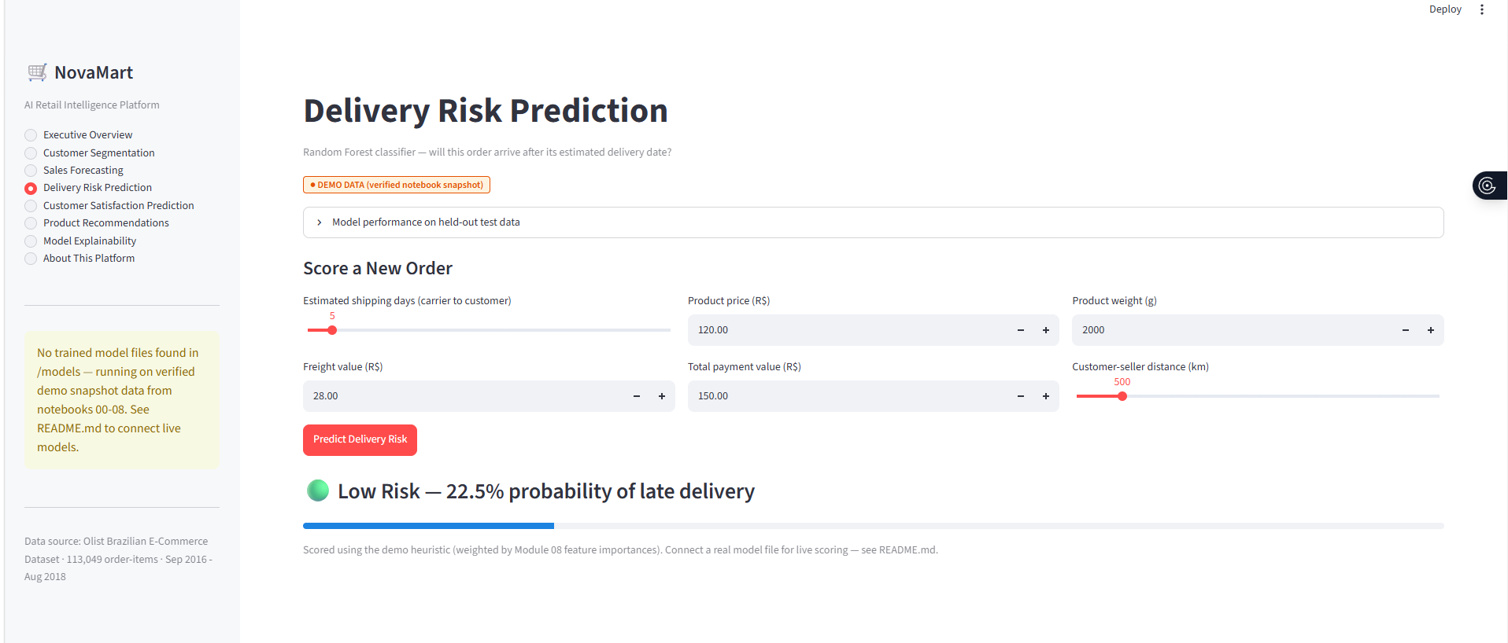
DEPLOYMENT
Live Scoring — Delivery Risk Prediction in Action
A user enters new order details and gets an instant delivery-risk score
15
Notes:
This page turns Module 05's Random Forest classifier into something a non-technical NovaMart employee can actually use: enter shipping days, price, freight, payment value, and distance, click Predict, and get an instant risk score with a plain-language label — here, Low Risk at 22.5%. This is the same feature set and the same feature-importance weighting from the explainability module, just made interactive. The satisfaction prediction page works identically.

Slide 16
SO WHAT?
Business Impact & Recommendations
Prioritise Retention Over Acquisition
97% single-purchase rate is NovaMart's single biggest growth lever — target Premium & At Risk segments directly.
1
Treat Delivery as the #1 Satisfaction Lever
Confirmed by both correlation and explainability analysis — invest in carrier monitoring and proactive delay alerts.
2
Use Predictive Flags as Decision Support
High precision, modest recall — deploy as prioritisation tools for ops & service teams, not full automation.
3
Strengthen Forecasting with More Signals
Add promo calendars, holidays & marketing spend, or move to monthly aggregation before using forecasts operationally.
4
Grow Repeat-Purchase Data
As retention improves, shift the recommendation engine toward deeper personalisation and collaborative filtering.
5
16
Notes:
Pulling all nine modules together into five concrete recommendations for NovaMart's management. The through-line across almost all of them is that logistics and retention, not acquisition or algorithmic sophistication, are where NovaMart's next investment dollar should go.

Slide 17
LOOKING AHEAD
Limitations & Future Enhancements
Limitations
Future Enhancements
Order-level features give limited signal for logistics outcomes — recall on rare late-delivery events stays low
Dataset is a fixed historical window (Sep 2016 – Oct 2018); no post-2018 market shifts are reflected
Association-rule mining was done at category level; product-level basket analysis could reveal more
NovaMart is fictional — some operational assumptions are illustrative, not drawn from a real company
Add exogenous regressors to forecasting; test non-linear models (gradient boosting, Prophet)
Enrich delivery features with real-time carrier tracking & seller-level history to lift recall
Extend recommendations to product-level rules & deeper collaborative filtering as repeat-purchase data grows
Add SHAP-based local, per-prediction explanations inside the dashboard
Connect the platform to a live transactional database for real-time scoring & alerting
17
Notes:
No project is finished — these are the limitations I'd flag to a hiring manager unprompted, and the concrete next steps I'd take with more time. Reporting both strengths and limits honestly is, in my view, itself part of the deliverable.

Slide 18
CAPSTONE RESULTS SUMMARY
One Platform. Every Result
Backed by Real Data.
9
113,049
3
1
Modules Delivered End-to-End
Orders Analysed
Trained Classifiers/Clustering Models
Deployed Streamlit Dashboard
GitHub repo · Live Streamlit dashboard · Full capstone report
Thank you — happy to take questions.
Notes:
To close: this project delivered nine fully working modules on a single 113,049-order dataset — trained and evaluated models for every prediction task, from segmentation through forecasting, delivery and satisfaction prediction, recommendations, and explainability — all tied together in a live, deployed dashboard. Just as importantly, every result I've presented today, the strong ones and the weak ones, is real, measured, and reproducible from the notebooks behind this project. Thank you — I'm happy to take questions.

